Slide 1
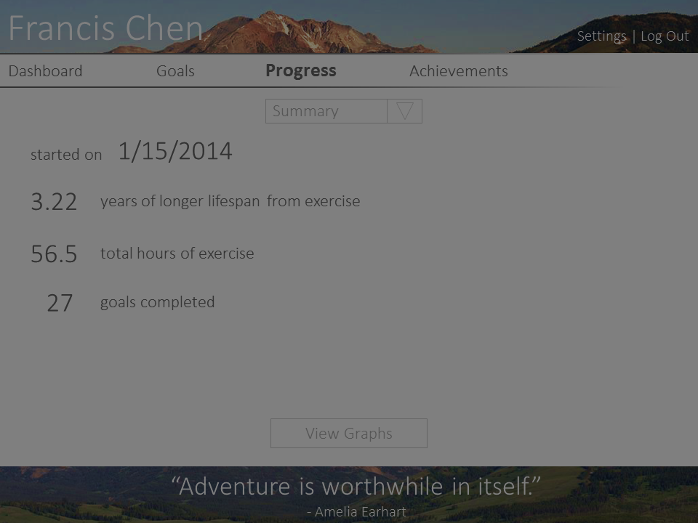
30 min.
1 day
All
Time
Week
Notes:
Time series instead of cumulative.

